Slide 1


WORKPLACE LAW UPDATE
October 18, 2023
Dawn J. Lanouette, esq.
Hinman, Howard & Kattell, LLP
80 Exchange Street| Binghamton, NY dlanouette@hhk.com | (607) 231- 6917
Attorney advertising

Slide 2


DISCLAIMER
This presentation is not intended to
be legal advice. It is for information only.
This may be considered attorney advertising. You should not rely on it as legal advice.
Please contact an attorney to discuss your specific situation.

Slide 3

WAGE AND HOUR LAW

Slide 4

Upstate NY Minimum Wage Increasing!
December 31, 2023 increases to $15.00 ($16 New York City and Nassau, Suffolk, and Westchester)
  $15.50 in 2024, then to $16 in 2025
Future Increases published on or before October 1 of each year

Slide 5
OTHER CHANGES
Tipped Service Workers
Year | New York City, Westchester, Nassau, Suffolk Counties | Upstate New York
2024 | $10.70 | $10.00
2025 | $11.00 | $10.35
2026 | $11.35 | $10.70
Minimum Weekly Wage Est. $1,125 Weekly

Slide 6

What About the Minimum Weekly Wage for Exempt?
Not Published Yet
Historically 75 times hourly minimum wage per week
Best Guess--increase from $1,064.25 weekly ($55,341 annually) to $1,124 weekly ($58,500 annually)

Slide 7

FEDERAL PROPOSED CHANGES TO OVERTIME RULES

Slide 8
WHAT’S IN THE PROPOSAL?
Applies to white collar exemptions—Executive, Professional, Administrative, Computer Professional
No increase for Outside Sales
Increase from $35,568 to $55,068 a year (from $684 per week to $1,059 per week)
California, Colorado, Maine, New York and Washington currently higher

Slide 9
ONE TIP . . .
Use the Increases as the Time to Audit
  Be Aware of Position Creep
  Use the Actual Tests—
  https://dol.ny.gov/system/files/documents/2021/12/administrative-employee-overtime-exemption-frequently-asked-questions.pdf
  https://dol.ny.gov/system/files/documents/2021/03/professional-employee-overtime-exemption-frequently-asked-questions.pdf
  https://dol.ny.gov/system/files/documents/2021/03/executive-employee-overtime-exemption-frequently-asked-questions.pdf

Slide 10

SIGNIFICANT STATUTORY DEVELOPMENTS

Slide 11

LAWFUL ABSENCES LAW
New York Labor Law Section 215

Slide 12

REQUIREMENTS OF THE LAW
Prohibits employers from “assessing any demerit, occurrence, or any other point, or deductions from an allotted bank of time, which subjects or could subject an employee to disciplinary action” for the use of any “legally protected absence under federal, local, or state law.”
Prohibits employer from subjecting employee to a loss of promotion or pay
Went into effect February 19, 2023

Slide 13

MAY NEED TO MODIFY:
Perfect Attendance Bonuses
Call Out Penalties
No Fault Attendance Policies

Slide 14

DIGITAL LABOR LAW POSTERS
Amendment to Labor Law 201

Slide 15
EMPLOYERS REQUIRED TO MAKE LABOR POSTERS AVAILABLE DIGITALLY
Old Rule—Commissioner makes posters available, employer required to post them (“on each floor of the premises”)
New Rule—Employer also required to provide digital copies
  Via “employer’s website or by email”
  All documents “required to be physically posted at a worksite pursuant to state or federal law or regulation”
Notice to employees that documents required for physical posting are also available electronically

Slide 16

HELPFUL TO KNOW WHERE TO GET THEM
Posters Available Here
https://dol.ny.gov/posting-requirements-0
https://www.dol.gov/general/topics/posters

Slide 17

New Law Concerning Mandatory Meetings
S4982/A6604) –Prohibits employers from disciplining employees who opt not to participate in meetings sponsored by the employer concerning the employer’s views on political and religious matters
What About Union Matters?

Slide 18

HARASSMENT AND DISCRIMINATION LAW UPDATE

Slide 19

NEW ANTI-HARASSMENT POLICY
https://dol.ny.gov/news/new-york-state-department-labor-unveils-strengthened-sexual-harassment-prevention-policy
Expanded Explanation of Supervisor responsibilities
Include remote workers
Defines different gender identities and expands on gender discrimination
Provides examples of sexual harassment and retaliation across a broader spectrum of careers.
Includes bystander intervention methods

Slide 20

NEW ANTI-HARASSMENT TRAINING MATERIALS
https://www.ny.gov/combating-sexual-harassment-workplace/sexual-harassment-prevention-model-policy-and-training
  Video
  Question Sheet

Slide 21
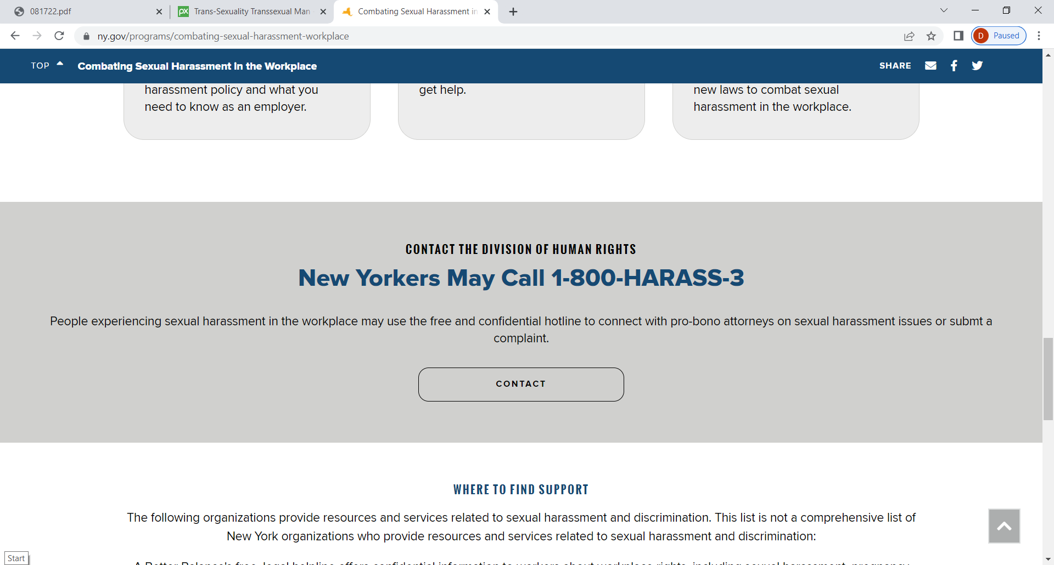
NEW 1-800 NUMBER FOR
HARASSMENT CLAIMS
https://dhr.ny.gov/sexual-harassment-hotline

Slide 22

ADDITION OF NEW CATEGORIES OF PROTECTION
New law adds citizenship and immigration status
“citizenship of any person or the immigration status of any person who is not a citizen of the United States”
Can still determine authorization to work status

Slide 23
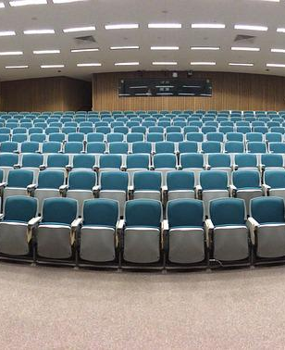
THIS APPLIES TO EVERYONE
REMEMBER TO UPDATE YOUR POLICY
Must provide information to employees on hiring AND at annual training. Remote/hybrid employees must have it electronically

Slide 24

EQUAL EMPLOYMENT OPPORTUNITY COMMISSION UPDATE

Slide 25
PROPOSED UPDATED GUIDANCE ON
PREVENTING HARASSMENT
Open for Comment Until Nov. 1
Context Matters
Includes updated and expanded definition of sex and gender based harassment
  Includes gender identity
  Includes intentionally using wrong pronouns
Workplace “culture” does not excuse harassment
Employee may be “harassed” by conduct directed at others

Slide 26

WHAT ELSE?
https://www.eeoc.gov/proposed-enforcement-guidance-harassment-workplace
Addresses Remote Work
Addresses Temporary Employment Agencies
Addresses Social Media and On-line Harassment
Provides Updated guidelines on policy issues
Provides Updated guidelines on Investigations

Slide 27
ENFORCEMENT PRIORITIES
https://www.eeoc.gov/strategic-enforcement-plan-fiscal-years-2024-2028
Focus on Underserved Workers
Recruitment and Training Policies
Focus on Increased Use of Technology
Emerging Issues
  Pregnancy and Childbirth
  Long Covid
  Technology
“Legal Issues”—Waivers, NDA, Non-Disparagement

Slide 28

PREGNANT WORKER’S FAIRNESS ACT
https://www.congress.gov/117/bills/hr2617/BILLS-117hr2617enr.pdf#page=1626
https://www.eeoc.gov/wysk/what-you-should-know-about-pregnant-workers-fairness-act

Slide 29

OVERVIEW OF THE LAW
The law “prohibits employment practices that discriminate against making reasonable accommodations for qualified employees affected by pregnancy, childbirth, or related medical conditions.
A qualified employee is an employee or applicant who, with or without reasonable accommodation, can perform the essential functions of the position, with specified exceptions.”

Slide 30

SPECIFIC PROVISIONS
Employer must make reasonable accommodations to known limitations of pregnant employees unless the accommodation would impose an undue hardship on an entity's business operation;
Cannot require a qualified employee to accept an accommodation other than any reasonable accommodation arrived at through an interactive process;
Cannot deny employment opportunities because the employer must make an accommodation;
Cannot require a pregnant employee to take paid or unpaid leave if another reasonable accommodation can be provided;
Prohibits taking adverse action in terms, conditions, or privileges of employment against a qualified employee requesting or using such reasonable accommodations.

Slide 31

SOME THOUGHTS . . .
If You Accommodate Worker’s Comp People, You Must Accommodate Pregnant Workers to at least the Same Extent
Applies to State and Municipal Entities (no 11th Amendment Immunity)
Went into effect on June 27, 2023

Slide 32
EEOC REGULATIONS
https://www.federalregister.gov/documents/2023/08/11/2023-17041/regulations-to-implement-the-pregnant-workers-fairness-act
Similar Structure to the ADA—reasonable accommodation unless can show an undue hardship
Recognizes that the accommodations are temporary
Allows Employee to Seek Damages for failure to accommodate

Slide 33
POSSIBLE ACCOMMODATIONS
job restructuring; part-time or modified work schedules; more frequent breaks; acquisition or modification of equipment, uniforms, or devices; allowing seating for jobs that require standing or standing in jobs that require sitting; appropriate adjustment or modification of examinations or policies; permitting the use of paid leave (whether accrued, short-term disability, or another type of employer benefit) or providing unpaid leave, including to attend health care-related appointments and to recover from childbirth; ^{[19]} assignment to light duty; ^{[20]} telework; and, accommodating a worker's inability to perform one or more essential functions of a job by temporarily suspending the requirement that the employee perform that function, if the inability to perform the essential function is temporary and the worker could perform the essential function in the near future.[

Slide 34
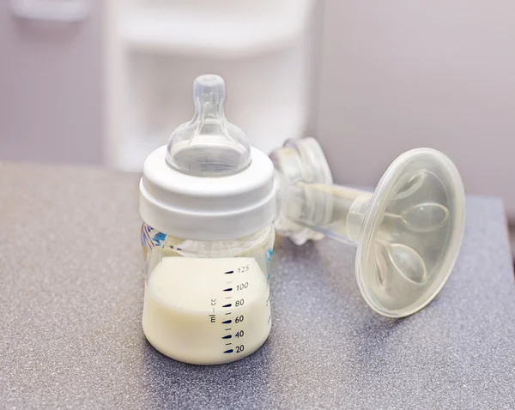
PUMP ACT FOR NURSING MOTHERS
Providing Urgent Maternal Protections for Nursing Mothers Act (P.L. 117-328)
https://www.fns.usda.gov/pl-117-328

Slide 35

WHAT’S IN THE LAW?
Protection for Employees to pump breast milk for up to 2 years after birth of child
Breaks only unpaid if employee is completely relieved of other duties
Expands protection to salaried employees
Includes protection even if child is stillborn or mother does not retain custody
Employer with fewer than 50 employees can be exempt if they can show it’s an undue hardship
Regulations to be issued within 60 days

Slide 36
WHAT ELSE?
DOL Guidance
Must Provide private location even while employee is at client or other location
Space must be completely free from surveillance
Employee must be completely relieved of duty for at least 21 minutes in order to not pay compensation
Frequently Asked Questions: https://www.dol.gov/agencies/whd/nursing-mothers/faq#:~:text=Under%20the%20PUMP%20Act%2C%20most,year%20after%20the%20child's%20birth.
Fact Sheet #73: https://www.dol.gov/agencies/whd/fact-sheets/73-flsa-break-time-nursing-mothers

Slide 37

NYS NURSING MOTHERS IN THE WORKPLACE ACT
Expands Existing Required Accommodations
New York Labor Law 206-c

Slide 38

WHAT’S IN THE LAW?
In effect on June 7, 2023
Up to 3 years post-birth of the child
New Requirements for the Location
  Cannot be a restroom
  Must be close to the employee’s work area
  Shielded from other individuals’ view and free from intrusion from other employees or the public
  Contain sufficient lighting
  Have a chair
  Have an open surface
  Be close to clean running water
  Contain at least one electrical outlet

Slide 39
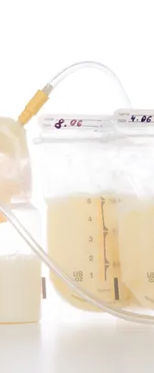
OTHER INFORMATION
New model policy and frequently asked questions: https://dol.ny.gov/breast-milk-expression-workplace
Employers required to provide policy to each employee upon hiring, annually, upon return from birth of a child.

Slide 40

I-9 VERIFICATION UPDATE

Slide 41
New Updated Form https://www.uscis.gov/i-9
Back to In Person Inspections EXCEPT:
  E-verify Users May Conduct Remote Review (https://www.uscis.gov/i-9-central/form-i-9-related-news/new-e-verify-employers-may-use-alternative-procedure-for-form-i-9-documents-examined-remotely-during#:~:text=If%20you%20choose%20to%20use,never%20in%2Dperson%20physically%20examined)

Slide 42
WHAT ABOUT THOSE REMOTELY INSPECTED DOCUMENTS DURING COVID?
https://www.uscis.gov/i-9-central/form-i-9-related-news/new-e-verify-employers-may-use-alternative-procedure-for-form-i-9-documents-examined-remotely-during#:~:text=If%20you%20choose%20to%20use,never%20in%2Dperson%20physically%20examined.
performed remote examination of an employee’s documents between March 20, 2020, and July 31, 2023;
been enrolled in E-Verify at the time they completed the Form I-9 for that employee;
created a case in E-Verify for that employee (except for reverification); and
be currently enrolled in and continue to participate in E-Verify.
Otherwise—must physically inspect all documents by August 30, 2023

Slide 43

PAID FAMILY LEAVE UPDATE

Slide 44

PAID FAMILY LEAVE 2023
Benefits at 12 weeks at 67% of wages up to statewide average weekly wage
Deduction down from 0.455% to 0.373% of an employee’s gross annualized wages, capped at $89,343.80
Maximum annual premium contribution of $333.25 per employee

Slide 45

NON-COMPETE AGREEMENTS

Slide 46
NEW YORK STATE LAW
Would go into effect 30 days after signing
Would Ban Non-Competes
Applies Prospectively—requiring a non-compete or attempting to enforce would invite a lawsuit
  What About Retrospectively?
Provides Private Right of Action Against Employer

Slide 47
EXCEPTIONS TO THE NY LAW
During a Fixed Term of Service
Non-Disclosure of Confidential Information
Non-Solicitation of Clients the Employee Learned about During Employment
  Wait! No Exception for Sale of a Business? Not yet.

Slide 48
FTC REGULATION
Rule would ban employers from using noncompete clauses with their workers, including independent contractors
Require employers to rescind existing noncompete clauses with workers and actively inform their employees that the contracts are no longer in effect.

Slide 49
PUBLIC COMMENT TOPICS
Whether franchisees should be covered by the rule
Whether senior executives should be exempted from the rule, or subject to a rebuttable presumption rather than a ban
Whether low- and high-wage workers should be treated differently under the rule

Slide 50

WHAT’S NEXT?
FTC Responds to Comments
Publishes Final Rule
Lawsuits Commence
Where to find more?
https://www.ftc.gov/news-events/news/press-releases/2023/01/ftc-proposes-rule-ban-noncompete-clauses-which-hurt-workers-harm-competition

Slide 51
OTHER ATTACKS ON NON-COMPETE AGREEMENTS
FTC LAWSUITS
https://www.ftc.gov/news-events/news/press-releases/2023/03/ftc-takes-action-against-another-company-imposed-harmful-noncompete-restrictions-its-workers
NLRB GUIDANCE AND CASE
https://www.nlrb.gov/news-outreach/news-story/nlrb-general-counsel-issues-memo-on-non-competes-violating-the-national
https://www.tradesecretsandemployeemobility.com/2023/06/articles/non-compete-agreements/nlrb-finds-its-first-noncompete-targetand-its-charges-go-well-beyond-an-overbroad-noncompete/

Slide 52

BOTTOM LINE:
NON COMPETE AGREEMENTS ARE RISKY
CONSIDER ALTERNATIVES:
  Non-Solicitation Agreements
  Confidentiality Agreements

Slide 53

Challenges to settlement agreements

Slide 54

WHO IS AFFECTED?
Anyone Who Is Not a Supervisor Under the National Labor Relations Act
  Definition Is Different From FLSA or Harassment Laws
Applies to Unionized and Non-Unionized Employers

Slide 55

RELEASES
Prohibits “Overly Broad” Releases
  Not clear what this means, but at a minimum must not prohibit employee from going to the NLRB

Slide 56

CHANGES--CONFIDENTIALITY
Restricts Confidentiality Clauses
  Trade Secret Restrictions are OK
  Amount Paid Is Likely OK
  Cannot Include All Terms of the Agreement
  Cannot Include Underlying Facts or Negotiations

Slide 57

RESTRICTS NON-DISPARAGEMENT
  Can Only Prohibit Defamatory Statements
  Statements That Are Made Knowing They Are Untrue or Made with Reckless Disregard for the Truth
    Note: Will Not Apply to Negative Opinions

Slide 58

WHAT ELSE SHOULD WE KNOW?
Proffering the Agreement, Even if Not Enforced Could Be a Violation
Entire Agreement Would Likely Be Void
Decision Applies Retroactively

Slide 59
SPEAK OUT ACT
Prohibits the enforcement of confidentiality or non-disparagement provisions in cases of sexual harassment or assault IF entered “before the dispute arises.”
https://www.congress.gov/bill/117th-congress/senate-bill/4524
https://www.littler.com/publication-press/publication/president-biden-enacts-speak-out-act-curtailing-use-pre-dispute-non

Slide 60

DON’T FORGET
NYS Restricts Settlement Agreements For Sexual Harassment and Discrimination Claims
Wage and Hour Settlements Have Restrictions

Slide 61

HANDBOOK DECISION AND GUIDANCE

Slide 62
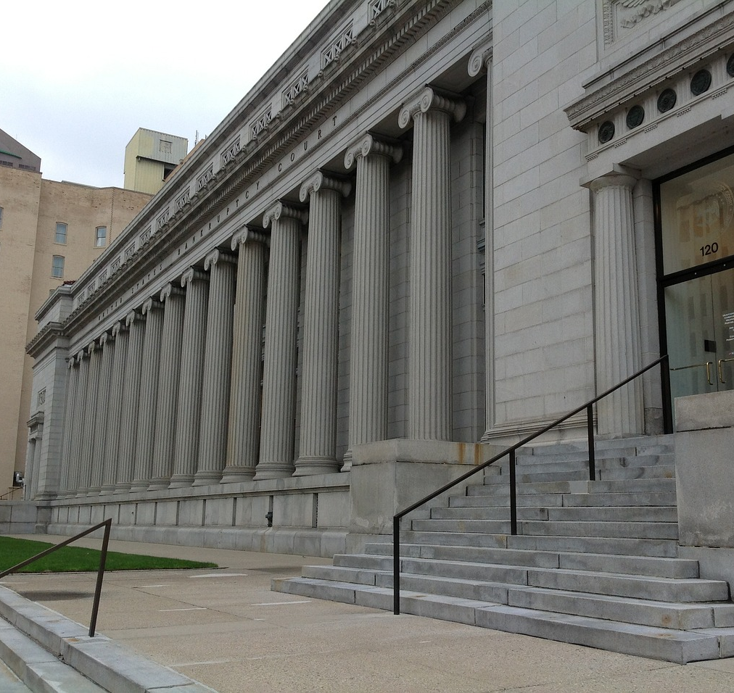
STERICYCLE DECISION
Employers burden--workplace conduct rules are narrowly tailored
Employer has a legitimate and substantial business interest protected by the rule

Slide 63

Rules to Review
Workplace Civility Rules (“respectful”, “professional”)
Restrictions on Recordings

Slide 64

REMOTE WORKERS
GUIDANCE
https://www.dol.gov/sites/dolgov/files/WHD/fab/2023-1.pdf

Slide 65

FAMILY AND MEDICAL LEAVE ACT
FOR REMOTE WORKERS

Slide 66
FMLA FOR REMOTE WORKERS
Worksite is not their home but where they report
Must consider actual hours worked in calculating 12 weeks (not just 40 hour work-week)
Eligible employee with a serious health condition that necessitates limited hours may use FMLA leave to work a reduced number of hours per day (or week) for an indefinite period of time as long as the employee does not exhaust their FMLA leave entitlement

Slide 67

FLSA GUIDANCE FOR REMOTE WORKERS

Slide 68
GUIDANCE ON REMOTE WORK PAY
Breaks of twenty minutes or less must be counted as hours worked. See 29 C.F.R. § 785.18
If employee has flexibility, periods of time relieved of work are not compensable if employee can effectively use the time for their own purpose.

Slide 69

SALARY DISCLOSURE LAW

Slide 70
WHAT’S IN THE REGULATIONS
https://dol.ny.gov/system/files/documents/2023/09/text-salary-transparency-8.28.23-for-website.pdf
Applies to Jobs Performed at least in part in New York or performed outside of New York, but Report to a New York Supervisor
Does not apply to temporary help firm listings unless for the help firm itself
All Advertisements regardless of format
Advertisements must contain a job description for the opportunity if a job description exists.

Slide 71
REGULATIONS CONTINUED
Base rate of pay, regardless of the frequency of payment
Range must be for a single opportunity and a single geographic location or region
minimum and maximum annual salary, or hourly rate, for an opportunity that the employer believes in good faith to be accurate at the time of the posting of an advertisement for such opportunity

Slide 72

WHAT’S NEXT?

Slide 73

ARTIFICIAL INTELLIGENCE IN THE WORKPLACE (AI)

Slide 74

WHAT SHOULD WE KNOW?
Hiring Programs
Chat GPT
Virtual Assistants and Chatbots
Discrimination Claims
Privacy/Intellectual Property Claims

Slide 75

DON’T FORGET. . .
Update Handbooks for new required policies and amendments
Annual Harassment Training
Wage Rate Sheets
Do a spot check on wage and hour
COVID Pay Is Still a Thing

Slide 76
HOW DO I KEEP UP?
HHK Lunch with a Lawyer Quarterly Topics
Newsletter
STAHR/Chamber Updates
Subscribe to Government Listserves

Slide 77

YOUR QUESTIONS

